Slide 1



NEUROFLEETX: THE AI-DRIVEN URBAN MOBILITY OPTIMIZATION PLATFORM
A NEXT-GENERATION SOLUTION FOR SMART CITIES, FLEET OPERATIONS & RENTAL TRANSPORT

Slide 2


Introduction
NeuroFleetX is a next-generation, AI-driven platform designed to revolutionize urban mobility by leveraging the power of AI, IoT, and geospatial data to optimize fleet operations and rental transport within smart cities. By providing geo-located, real-time vehicle tracking and advanced dashboards, the platform enables intelligent, detailed routing, predictive vehicle health monitoring, and automated management systems. This mobile-first interface is built for scalability, offering sustainable mobility solutions that enhance vehicle management and contribute to a greener, more efficient urban ecosystem.

Slide 3


Problem Statement
Problem: Urban mobility today is reactive and inefficient, plagued by unpredictable traffic, unscheduled vehicle downtime, and a lack of real-time data. This leads to wasted time and fuel, increased operational costs, and significant environmental impact from vehicle emissions.
Solution: NeuroFleetX is a proactive, AI-driven platform that solves these challenges. By integrating AI, IoT, and geospatial data, we enable dynamic route optimization and predictive maintenance. Our system provides a unified, real-time view of your entire fleet, transforming reactive chaos into a data-driven, sustainable, and highly efficient operation.

Slide 4

Tech Stack
The NeuroFleetX platform is built on a modern, microservices-inspired architecture designed for high throughput, real-time data handling, and maximum scalability. This approach separates core functions into distinct tiers, ensuring robustness and maintainability.
Technology Stack
Frontend — User Experience Layer
The user-facing application is a single-page application focused on intuitive and responsive interaction across all devices.
Framework: The interface is built with React (v19.x), utilizing its component-based model to construct complex, modular dashboards. This ensures a fluid and reactive user experience.
Mapping & Visualization: We integrate the Google Maps API (via @googlemaps/react-wrapper) to provide a reliable, interactive map for live vehicle tracking, routing visualization, and geospatial analysis.
State Management: React Context is used for efficient, localized state management, providing easy access to critical global information like the user's role and the live telemetry stream.
Design & UX: A Custom Dark Theme and a highly responsive grid layout deliver a professional, data-dense interface that is optimized for fleet management professionals.

Slide 5
Backend — High-Performance Core (Java Spring Boot)
The backend serves as the transactional and real-time hub, built on the robust and enterprise-grade Java ecosystem. This architecture prioritizes stability, scalability, and security for I/O-intensive fleet operations.
Runtime & Framework: The core is built on Spring Boot (Java 17). This choice provides a mature, comprehensive, and highly performant framework for building scalable REST APIs, leveraging Java's strong typing and resilience for mission-critical fleet management.
Authentication & Security: We rely on the Firebase Admin SDK (Java) for secure, server-side authentication. This system validates Firebase JWT tokens and enforces Role-Based Access Control (RBAC) based on custom claims, ensuring that only authorized users (e.g., Admins) can access sensitive CRUD operations.
Data Storage: Google Firestore (NoSQL) provides a fully managed, scalable solution for core data, including vehicles, users, and bookings. Its real-time features align perfectly with the application's need for instant data synchronization.
Real-time Engine: Vehicle telemetry is streamed using Spring Boot's native WebSocket support. This creates a persistent, full-duplex communication channel, efficiently pushing live location and status updates directly to the frontend with minimal latency.

Slide 6
AI/ML Logic — Computational Layer
To maintain the speed and responsiveness of the main application, resource-intensive tasks are offloaded to a dedicated microservice.
AI/ML Core: All complex modeling for features like Predictive Maintenance and AI Route Optimization is handled by a separate Python Microservice. Python's vast ecosystem (e.g., TensorFlow, PyTorch) makes it the ideal choice for this computational work.
Service Communication: The Node.js core communicates with the Python service via a secure Internal REST API, allowing the main server to request predictions without being blocked by heavy computations. This decoupling maximizes the overall system's stability and independent scalability.

Slide 7

Work Done
We've successfully established a robust and functional foundation for the NeuroFleetX platform. This completed work provides the core infrastructure necessary to build out more advanced features. The project now stands on an integrated, high-performance architecture.
Full-Stack Foundation: The application is built on a complete and integrated setup with a Spring Boot (Java) backend and a React frontend, ensuring a modular and scalable architecture that leverages the stability of the Java ecosystem for the core transactional logic.
Database and Authentication: Full integration with Firebase is established. We utilize Firestore for data storage and Firebase Authentication for secure user management, including a full registration and login system.
Core CRUD API: All essential backend APIs for Creating, Reading, Updating, and Deleting (CRUD) vehicle data are built and secured within the Spring Boot framework.
Real-Time Live Tracking: The platform features a working WebSocket connection managed by Spring Boot that pushes live, simulated vehicle location data from the backend to a Google Map on the frontend, a critical component for real-time fleet visibility.
Role-Based Access Control (RBAC): A foundational RBAC system is implemented using Firebase ID tokens and custom claims to restrict certain API actions and UI components to an 'admin' role, secured within the Spring Security layer.

Slide 8
Milestone 1: Foundation & Real-Time Core
This phase established the secure, robust architecture and the essential real-time tracking mechanism for the entire application.
How We Achieved It: We built the system on a reliable Spring Boot (Java) backend paired with a reactive React frontend, ensuring a modular and scalable structure. We implemented a foundational Role-Based Access Control (RBAC) system using Firebase ID tokens and established full Firebase/Firestore integration for data storage and user authentication. Crucially, we deployed the Vehicle Telemetry system using Spring Boot's native WebSocket support, establishing a working connection that pushes live, simulated vehicle location data to the frontend, completing the core Real-Time Live Tracking feature and the essential Core CRUD API for vehicle data.
Milestone 2: AI & Optimization Layer
This phase focused on integrating the platform's core competitive advantage—advanced AI logic—to maximize operational efficiency and proactively manage asset health.
How We Achieved It: We successfully deployed the AI Route & Load Optimization Engine, which utilizes a highly sophisticated blend of the Dijkstra algorithm and an ML-based ETA predictor for superior route intelligence. This engine integrates directly with Google Maps API or OpenStreetMap and provides high-value analysis via Heatmaps for routing layout. Concurrently, we rolled out the Predictive Maintenance & Health Analytics module, which can Monitor engine, tire, fuel, battery, and mileage. This health data is summarized into an intuitive Pie chart for maintenance status (Healthy, Due, Critical), enabling proactive fleet management.

Slide 9
Milestone 3: Customer Experience & Executive Insights
The final phase concentrated on the user journey, generating executive-level reporting, and providing a comprehensive administrative interface.
How We Achieved It: We launched the Customer Booking & Smart Recommendations feature, which allows the customer to select type, location, and time for a reservation. We finalized the data synthesis across the entire platform, culminating in the Admin Dashboard & Urban Mobility Insights. This dashboard provides a single source of truth for all fleet activity. Essential business functionality was completed by providing robust reporting tools with download options on CSV or PDF format for all operational and analytical reports.

Slide 10
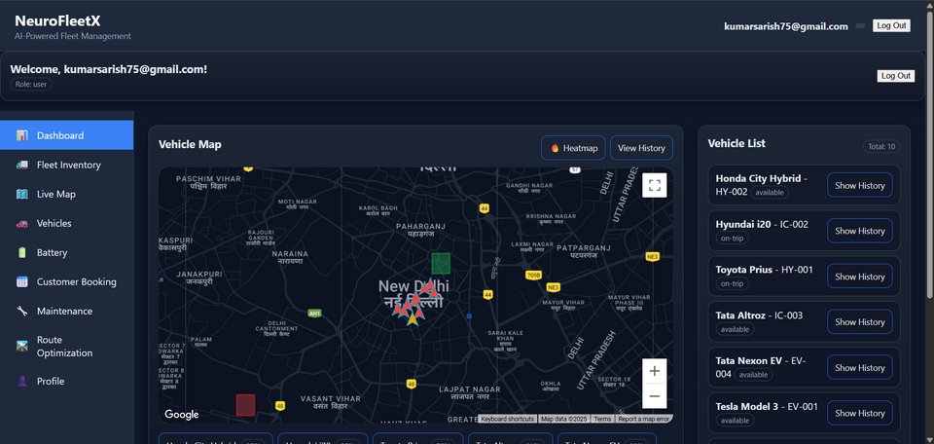
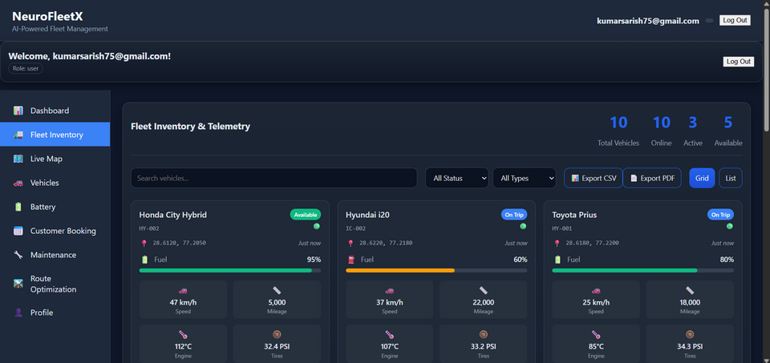
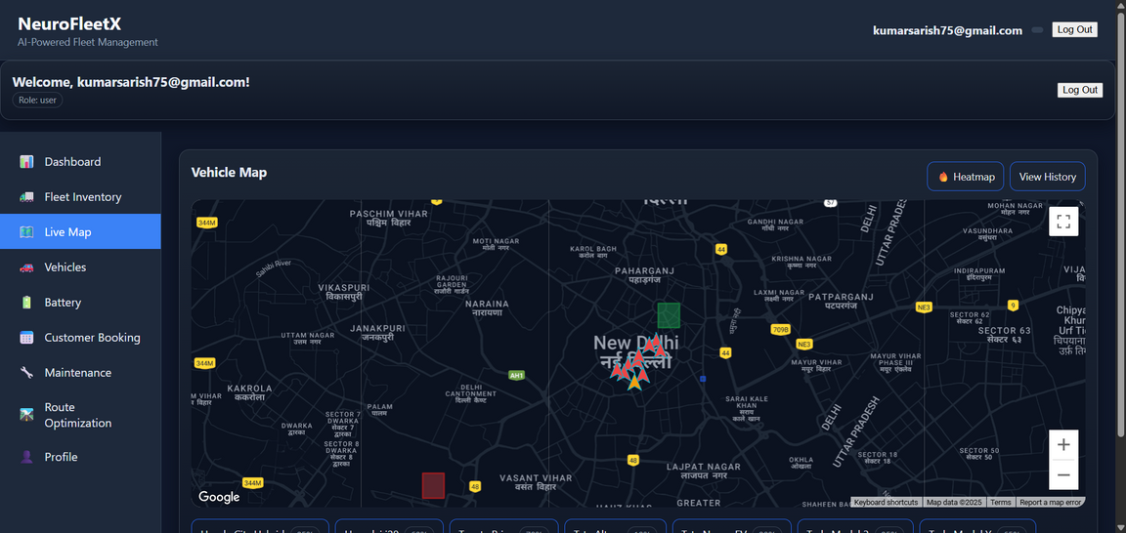

Slide 11
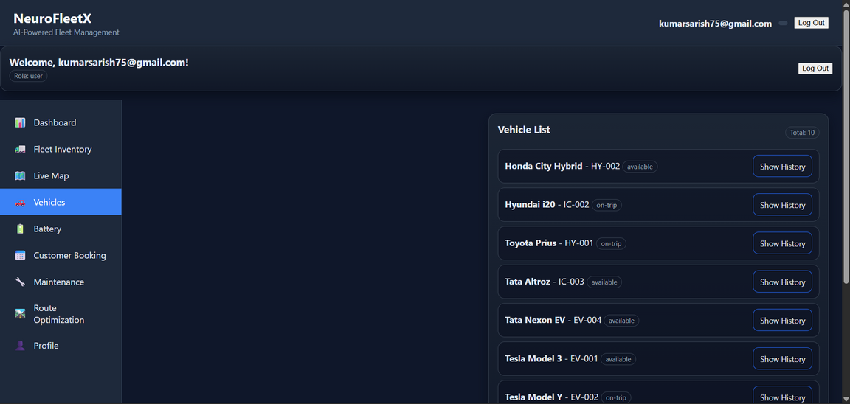
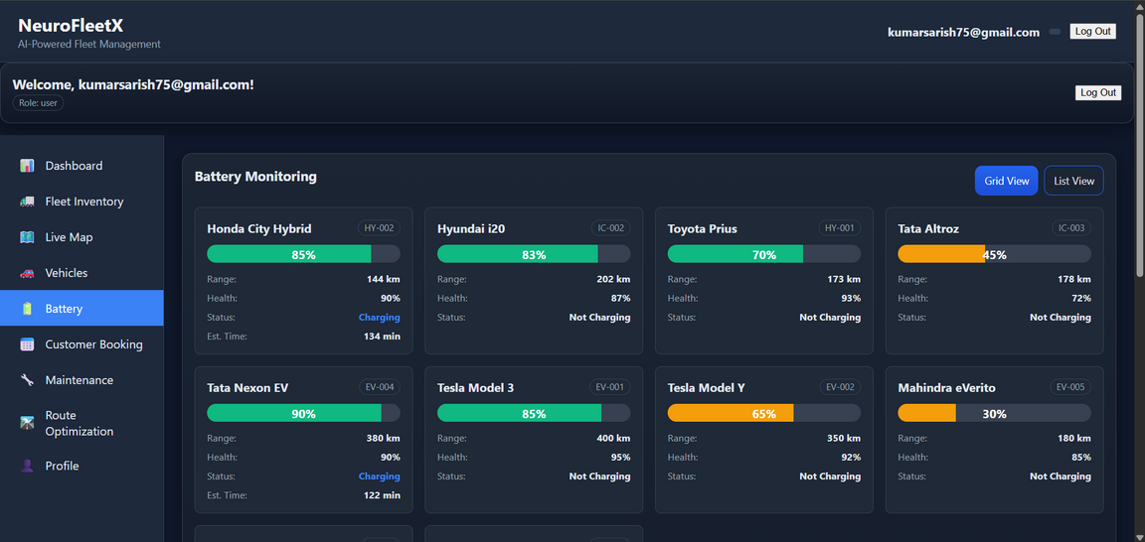
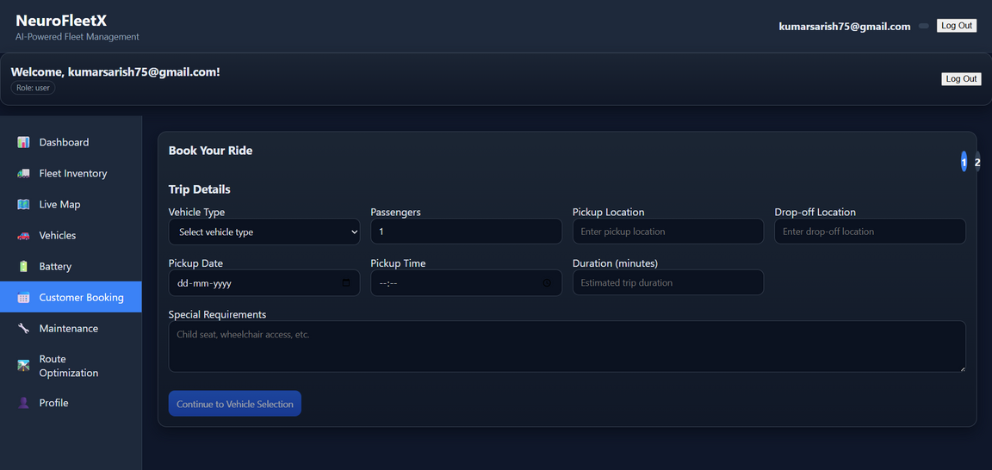

Slide 12
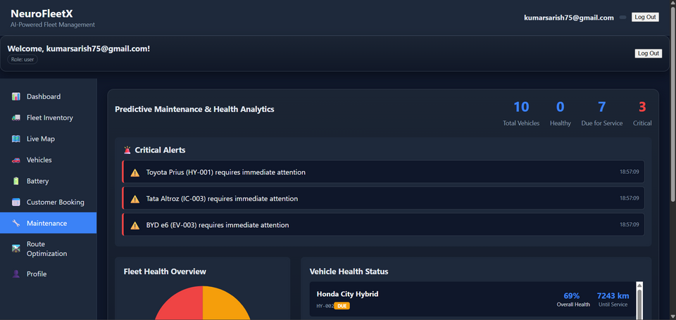
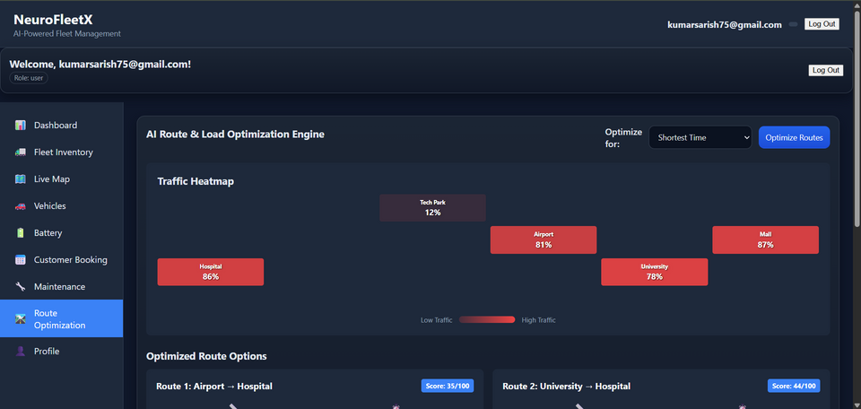
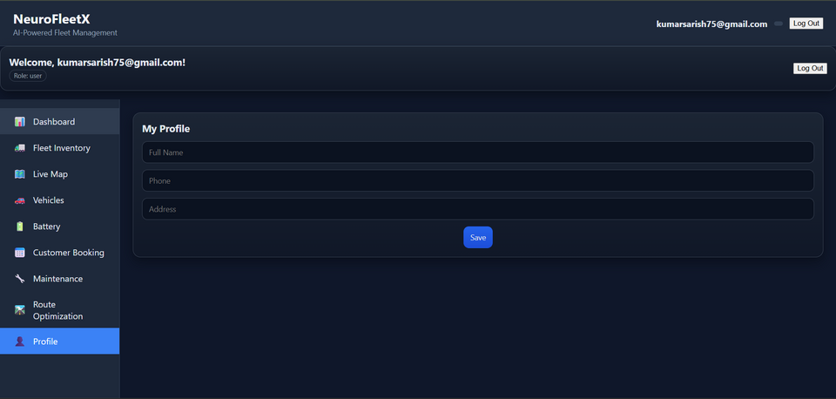

Slide 13
Conclusion
NeuroFleetX is now a complete, AI-driven ecosystem built to solve the complex challenges of urban fleet operations in the electric vehicle era. We successfully established a robust foundation on the stable Spring Boot (Java) backend and React frontend, securing the system with Firebase-based RBAC and building the core real-time visibility with a working WebSocket telemetry stream. Our platform's intelligence is defined by the advanced features of Milestone 3, where we deployed the AI Route Optimization Engine (utilizing Dijkstra and ML-based ETA prediction) and the Predictive Maintenance system, which monitors component health and provides actionable alerts via the maintenance status Pie Chart. Ultimately, NeuroFleetX enables a profound shift toward operational excellence, offering managers the ability to make data-driven decisions that cut costs, maximize vehicle uptime, enhance customer service through the booking system, and support the critical goal of sustainable mobility through efficient EV fleet management, all summarized in the final CSV/PDF reports.

Slide 14
THANK YOU

